Slide 1
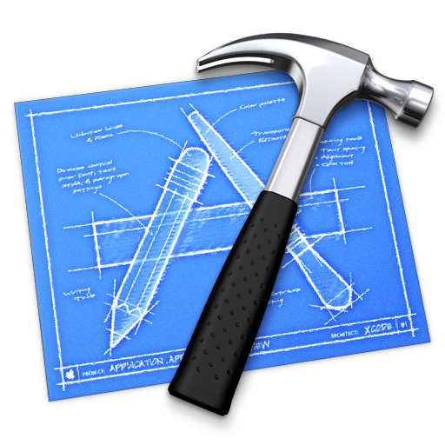
Table View Search
Trinh Minh Cuong
cuong@techmaster.vn
Notes:
Tham khảo kỹ
https://developer.apple.com/library/ios/#DOCUMENTATION/UserExperience/Conceptual/TableView_iPhone/AboutTableViewsiPhone/AboutTableViewsiPhone.html#//apple_ref/doc/uid/TP40007451

Slide 2
Cutomize Table VIEW CELL

Slide 3
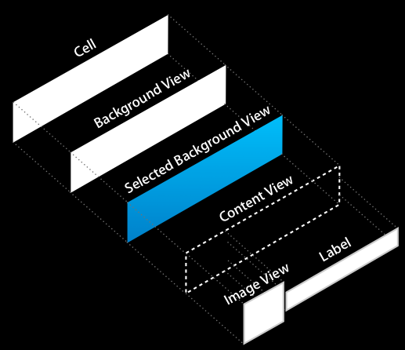

Slide 4
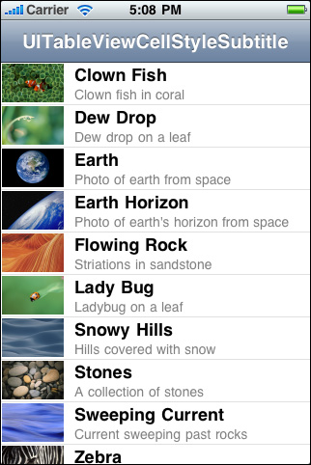
(UITableViewCell *)tableView:(UITableView *)tableView
cellForRowAtIndexPath:(NSIndexPath *)indexPath {
UITableViewCell *cell = [tableView dequeueReusableCellWithIdentifier:@"MyIdentifier"];
if (cell == nil) {
cell = [[[UITableViewCell alloc] initWithStyle:UITableViewCellStyleSubtitle reuseIdentifier:@"MyIdentifier"] autorelease];
cell.selectionStyle = UITableViewCellSelectionStyleNone;
}
NSDictionary *item = (NSDictionary *)[self.content objectAtIndex:indexPath.row];
cell.textLabel.text = [item objectForKey:@”Title"];
cell.detailTextLabel.text = [item objectForKey:@”subTitle"];
NSString *path = [[NSBundle mainBundle] pathForResource:[item objectForKey:@"imageKey"] ofType:@"png"];
UIImage *theImage = [UIImage imageWithContentsOfFile:path];
cell.imageView.image = theImage;
return cell;
}

Slide 5
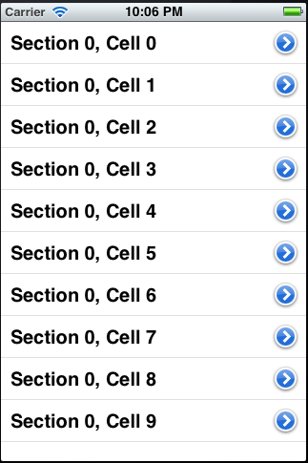
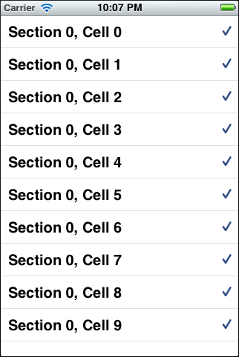
result.accessoryType = UITableViewCellAccessoryDetailDisclosureButton;
typedef enum {
UITableViewCellAccessoryNone,
UITableViewCellAccessoryDisclosureIndicator,
UITableViewCellAccessoryDetailDisclosureButton,
UITableViewCellAccessoryCheckmark
} UITableViewCellAccessoryType;

Slide 6
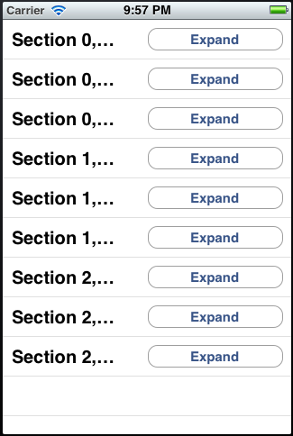
result.textLabel.text = [NSString stringWithFormat:@"Section %ld, Cell %ld",
(long)indexPath.section,
(long)indexPath.row];
UIButton *button = [UIButton buttonWithType:UIButtonTypeRoundedRect];
button.frame = CGRectMake(0.0f, 0.0f, 150.0f, 25.0f);
[button setTitle:@"Expand"
forState:UIControlStateNormal];
[button addTarget:self
action:@selector(performExpand:)
forControlEvents:UIControlEventTouchUpInside];
result.accessoryView = button;
return result;

Slide 7
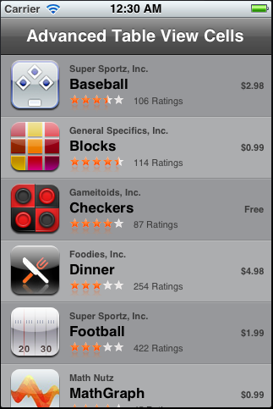
Advanced Customed Table View Cell

Slide 8
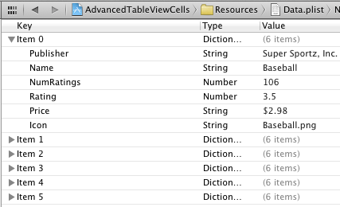
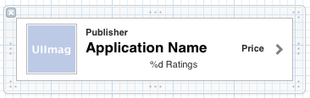
Advanced Customed Table View Cell
UITableViewController
UITableView
RootViewController
ApplicationCell
RatingView
uses
owns
IndividualSubviewsBasedApplicationCell
NSArray *data
owns
Data.plist
CompositeSubviewBasedApplicationCell
Layout using Xib
HybridSubviewBasedApplicationCell
Notes:
See more at http://runmad.com/blog/tag/uitableview/

Slide 9
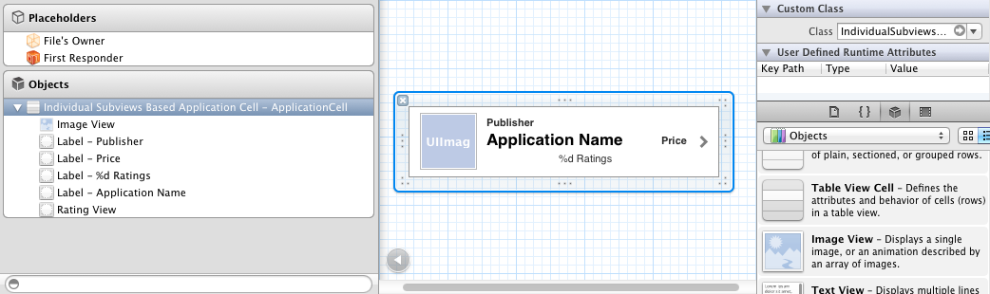
[self.cellNib instantiateWithOwner:self options:nil];
cell = tmpCell;
self.tmpCell = nil;
1- Load Nib
2- Associate loaded Nib with tmpCell
3- Assign tmpCell to each cell

Slide 10
HOW to LOAD DATA FROM PLIST

Slide 11
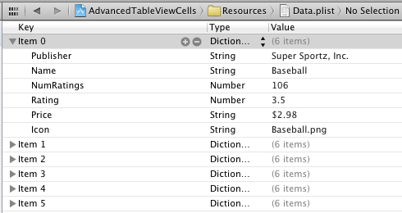
Load data from plist to model
NSString *dataPath = [[NSBundle mainBundle] pathForResource:@"Data" ofType:@"plist"];
self.data = [NSArray arrayWithContentsOfFile:dataPath];

Slide 12
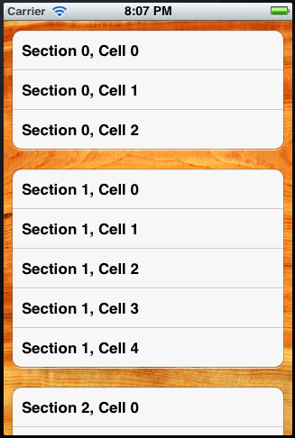
Customize backgroud
UIImage *backgroundImage = [UIImage mageNamed:@"woodgrain.jpg"];
self.myTableView.backgroundView = [[UIImageView alloc]
initWithImage:backgroundImage];

Slide 13
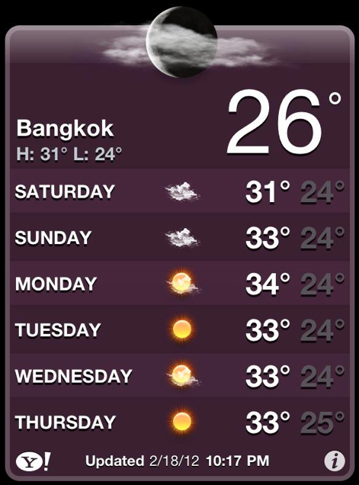
Custom header section
Header and Footer of Sections
– viewForHeaderInSection:
– viewForFooterInSection:
– heightForHeaderInSection:
– heightForFooterInSection:
Notes:
http://www.theflashfish.com/?p=91
See CustomTableHeaderExample

Slide 14
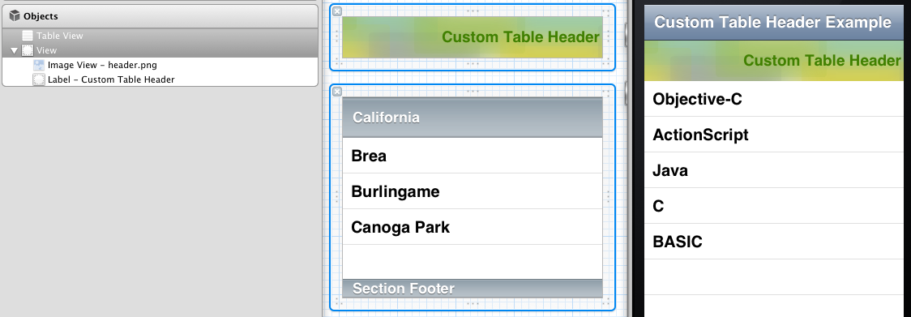
@interface RootViewController : UITableViewController {
IBOutlet UIView *headerView;
NSArray *tableData;
}
@property (nonatomic, retain) UIView *headerView;
@property (nonatomic, retain) NSArray *tableData;
Notes:
http://www.theflashfish.com/?p=91
See CustomTableHeaderExample

Slide 15
Search in table view

Slide 16
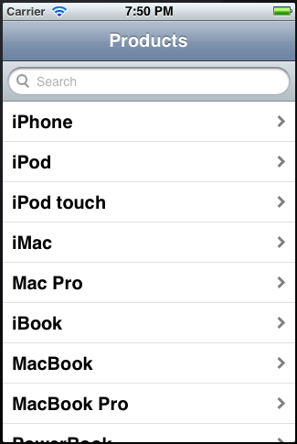
Search for UITableViewController
UISearchDisplayController
owns
UITableViewController
In fact, UITableViewController inherits UIViewController.
UIViewController has pointer to UISearchDisplayController
Notes:
Example “TableSearch”

Slide 17
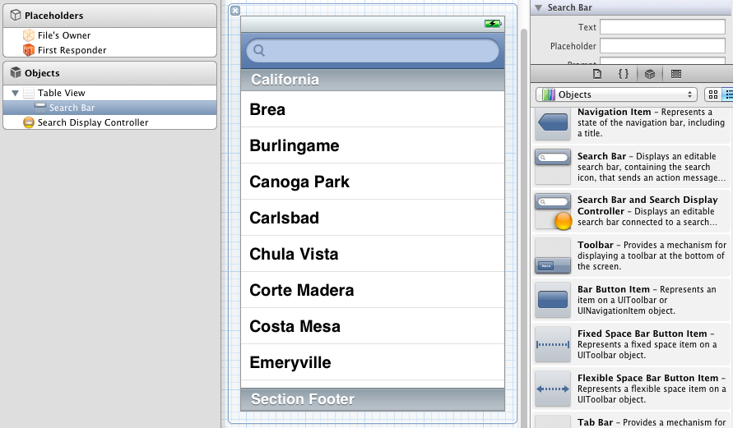
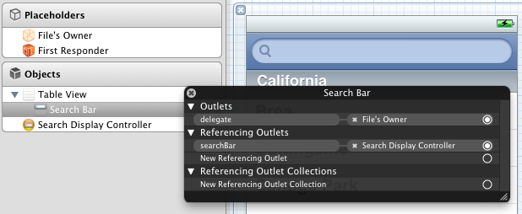
Steps
In IB, drag SearchBar and Display Controller to TableView
Make ViewController to conform UISearchDisplayDelegate, UISearchBarDelegate

Slide 18
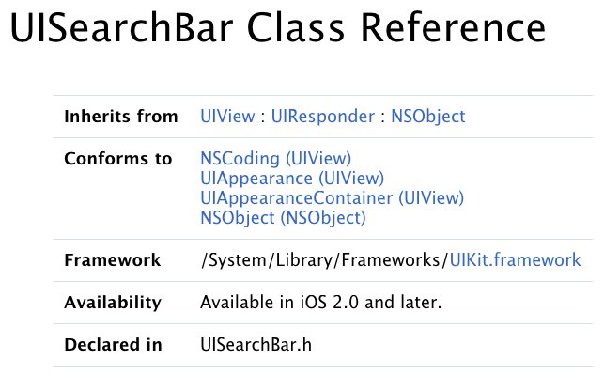

Slide 19
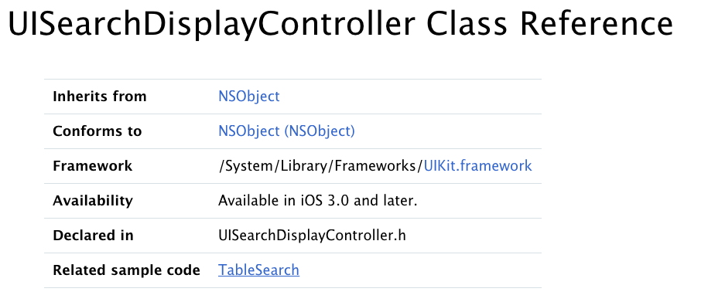

Slide 20
A search display controller manages display of a search bar and a table view that displays the results of a search of data managed by another view controller.
You initialize a search display controller with a search bar and a view controller responsible for managing the original content to be searched.
When the user starts a search, the search display controller is responsible for superimposing the search interface over the original view controller’s view and showing the search results.

Slide 21
UISearchDisplayDelegate
Search State Change
– searchDisplayControllerWillBeginSearch:
– searchDisplayControllerDidBeginSearch:
– searchDisplayControllerWillEndSearch:
– searchDisplayControllerDidEndSearch:
Loading and Unloading the Table View
– searchDisplayController:didLoadSearchResultsTableView:
– searchDisplayController:willUnloadSearchResultsTableView:
Showing and Hiding the Table View
– searchDisplayController:willShowSearchResultsTableView:
– searchDisplayController:didShowSearchResultsTableView:
– searchDisplayController:willHideSearchResultsTableView:
– searchDisplayController:didHideSearchResultsTableView:
Responding to Changes in Search Criteria
– searchDisplayController:shouldReloadTableForSearchString:
– searchDisplayController:shouldReloadTableForSearchScope:

Slide 22
Insert, Delete, Move Rows & Selections

Slide 23
Homework
Create weather forecast GUI like this
Create searchable table view of product list: product photo thumbnail, product name, short description, price and rating

Slide 24
Table Badget
http://www.tuaw.com/2010/01/07/iphone-devsugar-simple-table-badges/

